Slide 1
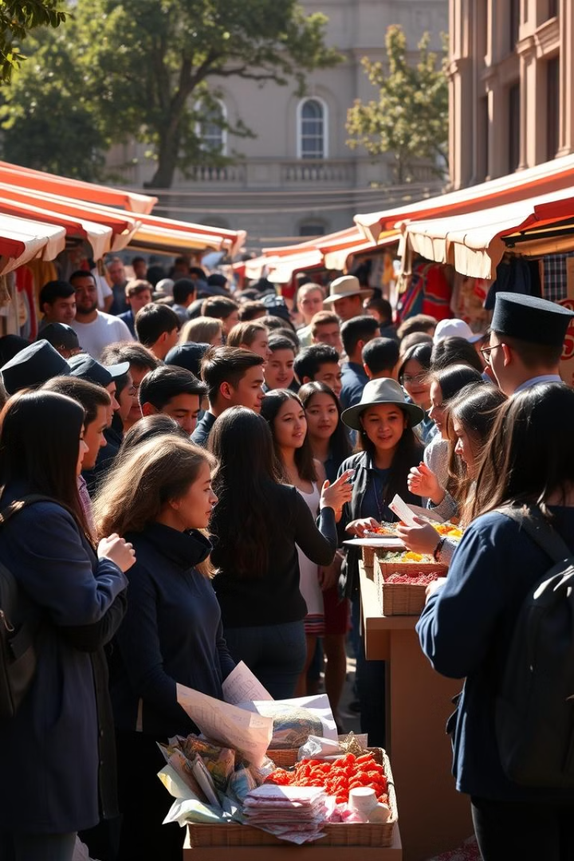
Introducing the 1337 Marketplace
Welcome, 1337 students! We present a platform made for you. Connect, trade, and thrive within our exclusive student community. Let's dive in and discover the endless possibilities.

Slide 2
The Problem: Unmet Needs
Lack of Focus
Inconvenience
No dedicated platform exists for 1337 students. Existing options don't cater to our unique needs.
Current solutions lack security and convenience. Trading and connecting is difficult within 1337.
Avito and Glovo don't quite cut it for campus life. The perfect solution is needed to connect 1337 students.

Slide 3
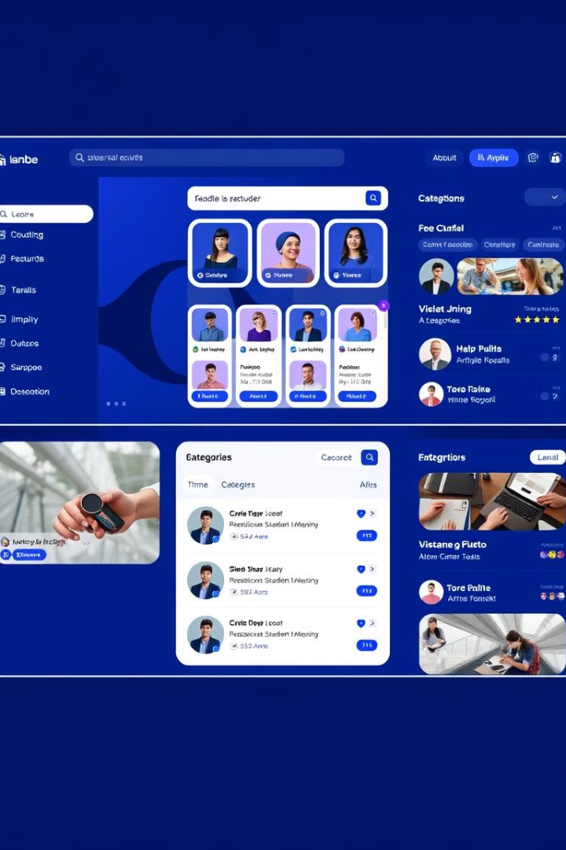
Our Solution: A Student-Exclusive Platform
1
Buy & Sell
2
Offer Services
List and find items, Avito-style. Buy and sell gadgets, books, and accessories.
Post or search for services, freelance-style. Get tutoring, coding help, and design work.
3
P2P Delivery
Request and fulfill deliveries, Glovo-style. Connect students for on-campus deliveries.
We're bringing together buying, selling, and peer-to-peer services. Exclusively for 1337 students across all campuses!

Slide 4




Key Features: Streamlining Campus Life
Secure Transactions
Location-Based Services
Real-Time Communication
Ensure safe and reliable payments. Protect users from fraud.
Find nearby trades and deliveries. Connect within your campus network.
Chat with buyers, sellers, and helpers. Negotiate deals and coordinate tasks.
We make campus transactions smoother than ever. Secure, local, and always connected.

Slide 5




User Roles: Powering the Marketplace
Sellers & Providers
List your products and services. Reach a wide student audience.
Buyers & Clients
Browse, connect, and negotiate deals. Find what you need easily.
Delivery Helpers
Accept delivery tasks and earn. Help your fellow students on campus.
Our platform empowers every student. Whether you're selling, buying, or delivering.

Slide 6

Benefits: Unlock Your Potential
Easy to Use
Campus Focused
Earn & Save
Simple and intuitive interface. Seamless navigation for all users.
Tailored for 1337 student life. Connect with local resources and peers.
Make money or find deals. Unlock new opportunities on campus.
The platform designed with students in mind. To create a seamless, beneficial experience.

Slide 7
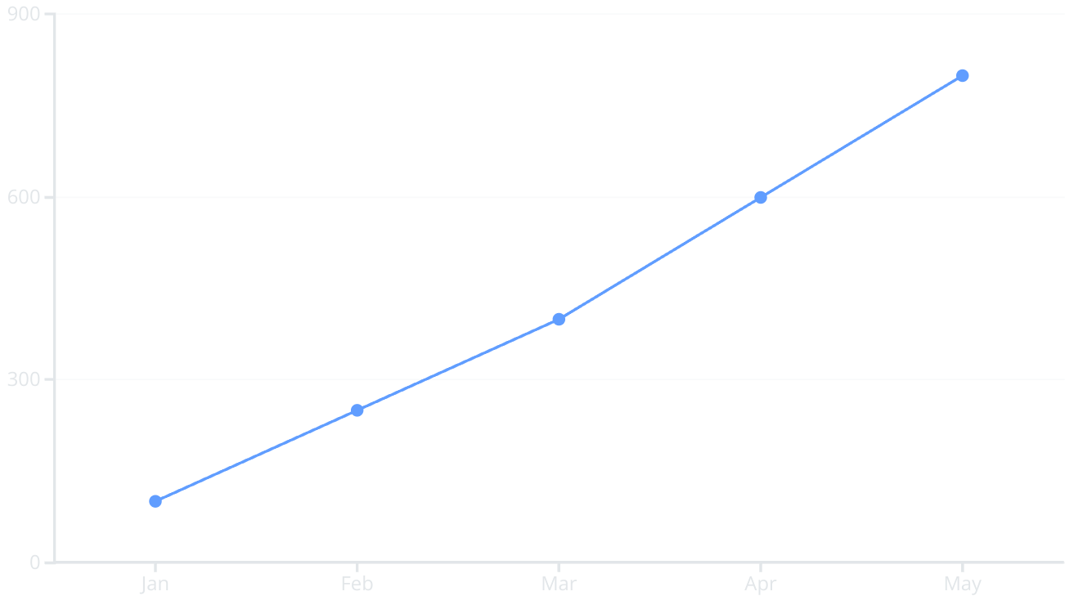
Marketplace Growth
The chart above displays the growth of the marketplace in the last 5 months. We are seeing substantial month-over-month growth.

Slide 8
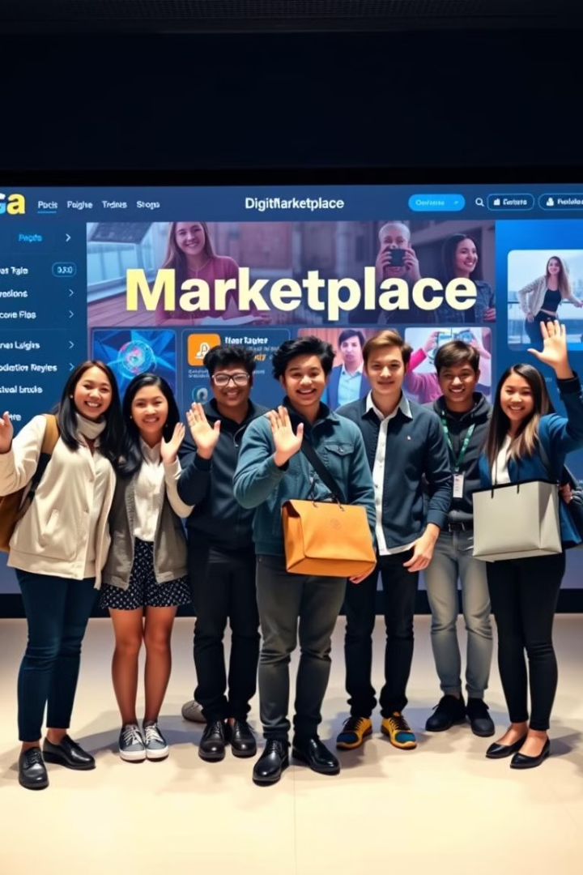
Conclusion: Join the 1337 Marketplace
Ready to transform campus life? Our platform is your gateway to connecting with peers, trading goods, and unlocking opportunities. Join us today!
Thank you for your time. Let's build a thriving student community together.

